Slide 1

Attachment J: JDA Hardware Architecture

Slide 2
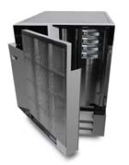



Proposed Technical Architecture
PMM/E3/
IBM LPAR appropriately sized
RetailIDEAS
Could be on the same IBM LPAR
SAN
Merchandising Clients
Citrix server
4 way with
4Gb memory
Store Portals 2 servers
4 way with 4Gb memory
App Servers for Arthur / Intellect / Vista
PMM
RetailIDEAS
Arthur
Portals
HEAD OFFICE LAN
TCP/IP Backbone
VPN
Internet
Stores
VPN
WAN
STORE LAN
External
Clients
ISP Autostar
POS
Store Portals

Slide 3
PMM, Replenishment and Arthur
Server
  Unix (AIX, HP, Solaris,…)
    IBM p690 8 - 12 way with 1Gb memory per processor, 1Tb DASD (ALL to be verified post sizing exercises)
  Windows NT (not recommended at this time due to size constraints)
Database
  Oracle 9i
Development Tools
  Oracle PL*SQL
  Uniface 7.2 for GUI
  C
  .NET for Replenishment and Arthur
Client
  Windows 98/NT/2000
  Pentium 266+, 128MB Ram+, 300MB DASD

Slide 4
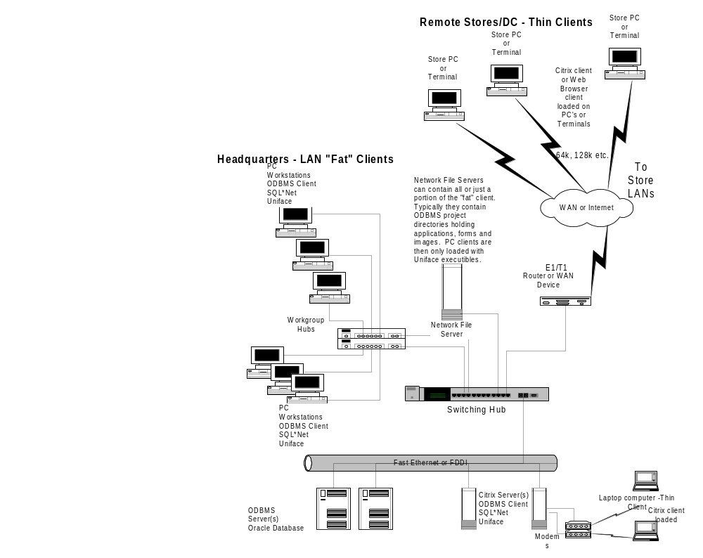
PMM deployment
possibilities
Notes:
We will work with you to determine a Global System Image. The main point here is to determine the hardware that fits the customer environment. We will work out how to make our solution fit that environment.

Slide 5
Retail IDEAS
Server
  Unix (AIX, HP/UX)
    Probably on the same chasis of the PMM box, 4 way processor, 8GB RAM, 1TB DASD
  AS400 (not recommended at this time)
  Windows NT (not recommended at this time)
Database
  Oracle 9i
  DB2/400 (not recommended at this time)
  Microsoft SQL Server 7.0 (not recommended at this time)
Development Tools
  Silvon (PowerBuilder)
  Java
  Visual Studio
Client
  Windows 98/NT/2000
  Pentium 266+, 128MB Ram+, 300MB DASD+

Slide 6
Store Portals / Registry
Servers
  Unix/NT DB Server:
    Uses PMM DB Server
  Windows 2000 App Server(s)
    Pentium III 700+ (4-way), 2GB RAM, 20GB DASD
Database
  Oracle 9i
Development Tools
  Visual Studio
  DHTML
  ASP
  XML
  .NET
Client
  Windows 98/NT/2000 (IE 5.0+)

Slide 7
Store Portal Architecture
Data Tier
  Oracle Database
  ODBMS Data Structures & Store Procedures
  Native Oracle SQL Data Access
  Visual C Based Data Access Layer
  ADO Record Sets Served From Access Layer

Slide 8
Store Portal Architecture
Services Tier
  Windows 2000 Operating System
  Internet Information Server
  COM+ Component Services
  Business Logic in Visual Studio Based COM Components
  Server Logic Scripted in Active Server Pages
  XML Message Based Interfaces Served to Presentation Layer or Other Subscribers

Slide 9
Store Portal Architecture
Client Tier
  Internet Explorer provides browser
  DHTML used for page description
  Document Object Model (DOM) for access to out of process components
  VB Script for scripting presentation logic
  ActiveX for robust visual controls
  XML data islands for dynamic presentation control

Slide 10
Other Tools…
Uniface Run-Time (included w/ODBMS)
Uniface PolyServer (optional – no additional fee)
Microsoft IIS (for Portals/Affinity)
SyncSort (Arthur)
Oracle ODBC Driver
Pro*C
Unix C Compiler
Oracle NET8 Client
Native or 3rd Party Scheduler

